Slide 1

Mini Project- Airline Reservation System
Group 1
GLC-Talawade-Pune
7th January, 2019
Notes:
Copyright © 2011 IGATE Corporation (a part of Capegemini Group). All rights reserved.
No part of this publication shall be reproduced in any way, including but not limited to photocopy, photographic, magnetic, or other record, without the prior written permission of IGATE Corporation (a part of Capegemini Group).
IGATE Corporation (a part of Capegemini Group) considers information included in this document to be confidential and proprietary.

Slide 2
Team Members
164277 - Aishwarya Keshavrao Deshpande
164279 - Alamgir Mohammad
164364 - Amit Kumar Potdar
164282 - Anish Hemant Gawde
164273 - Avinash Chauhan
164272 - Chincholikar Sayali Sanjay
164289 - Hemangee Tanay Joshi

Slide 3
Project Details
This project is aimed at developing an Airline Reservation System (ARS) for customers.
This airline portal is a solution for managing customer and flight information for an airline.
The primary function of the portal is to manage flight information and perform reservations and cancellations.
However, the duties in this airline also involve the status of flights, managing account of admin and generating revenue to interpret airline performance.
Technology used in our project:
Presentation Layer : WPF – 4.5
Business Layer : C# - 5.0
Database Layer : SQL Server 2012

Slide 4
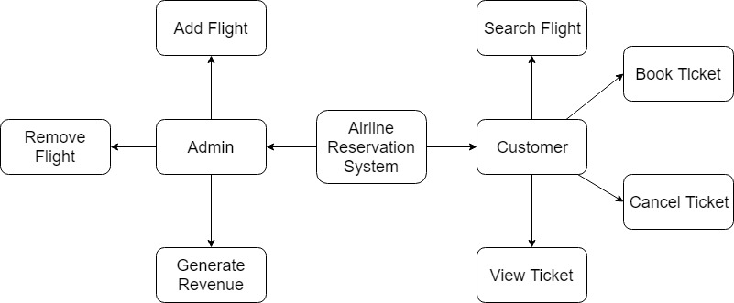
Diagram Depicting Entire Project

Slide 5
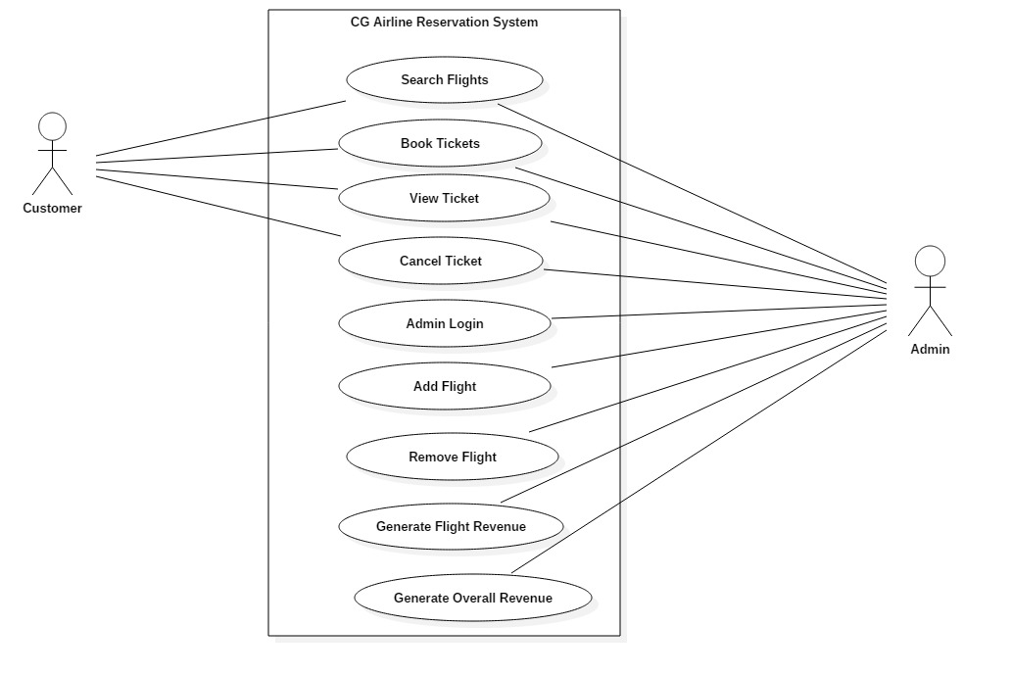
Use Case Diagram

Slide 6
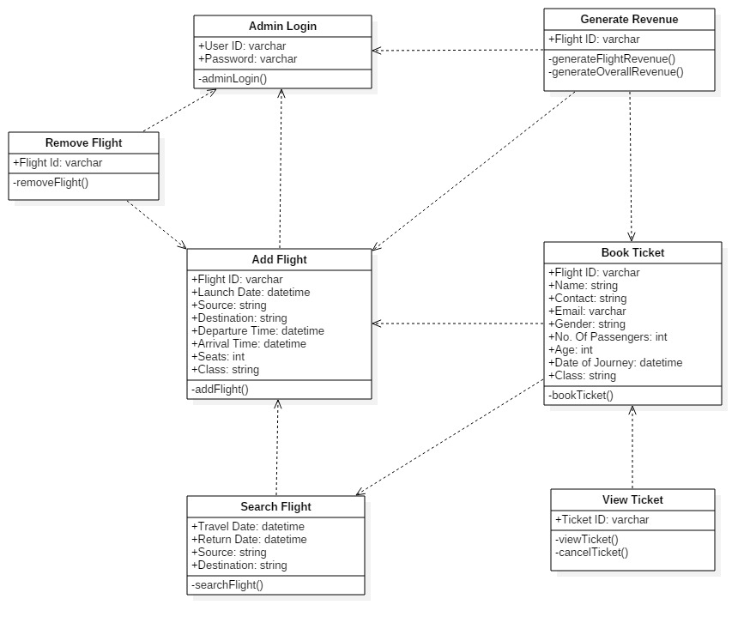
Class Diagram

Slide 7
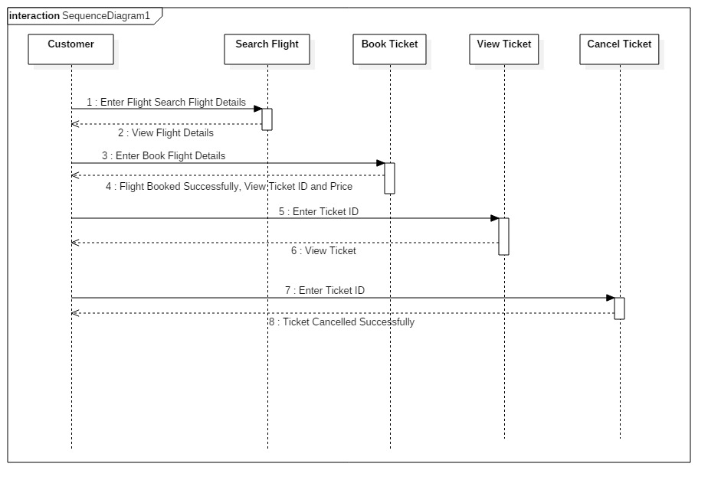
Sequence Diagram For Customer

Slide 8
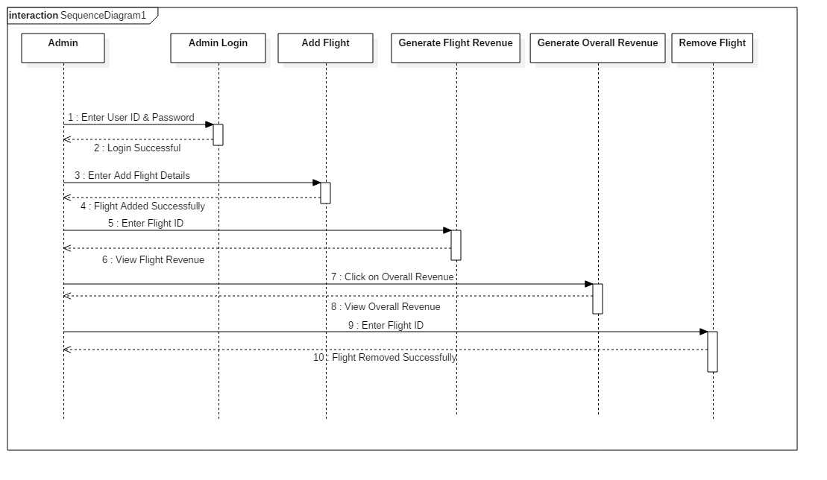
Sequence Diagram For Admin

Slide 9
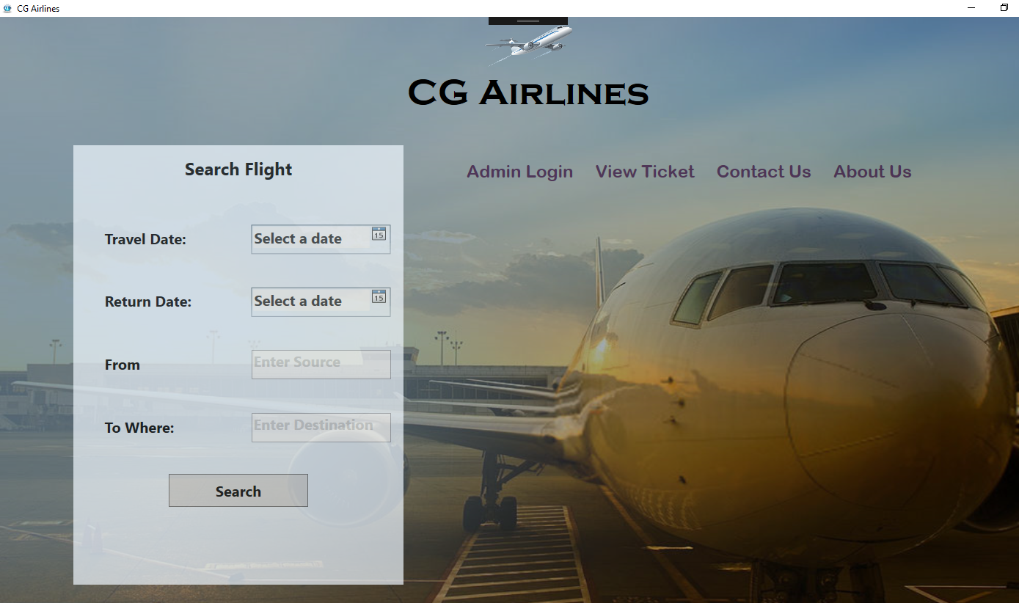
Home Page

Slide 10
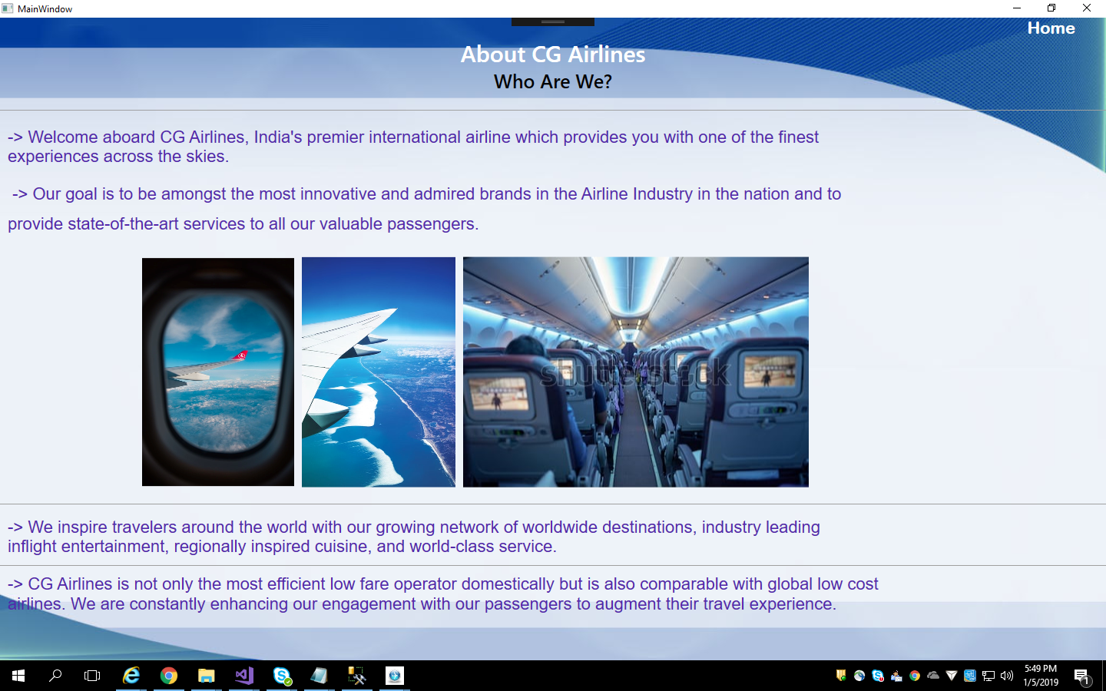
About Us

Slide 11
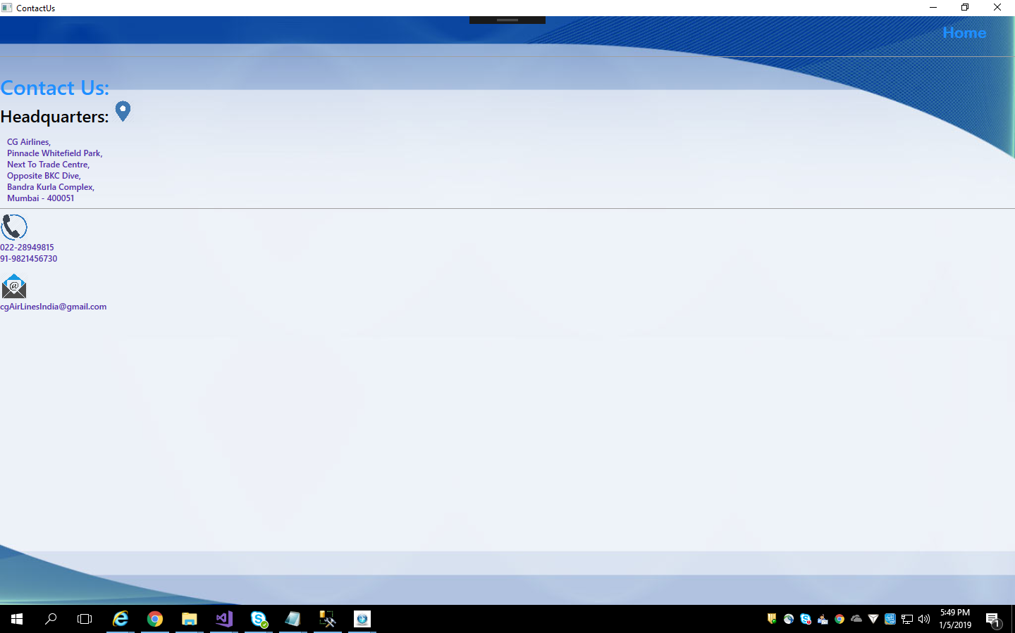
Contact Us

Slide 12
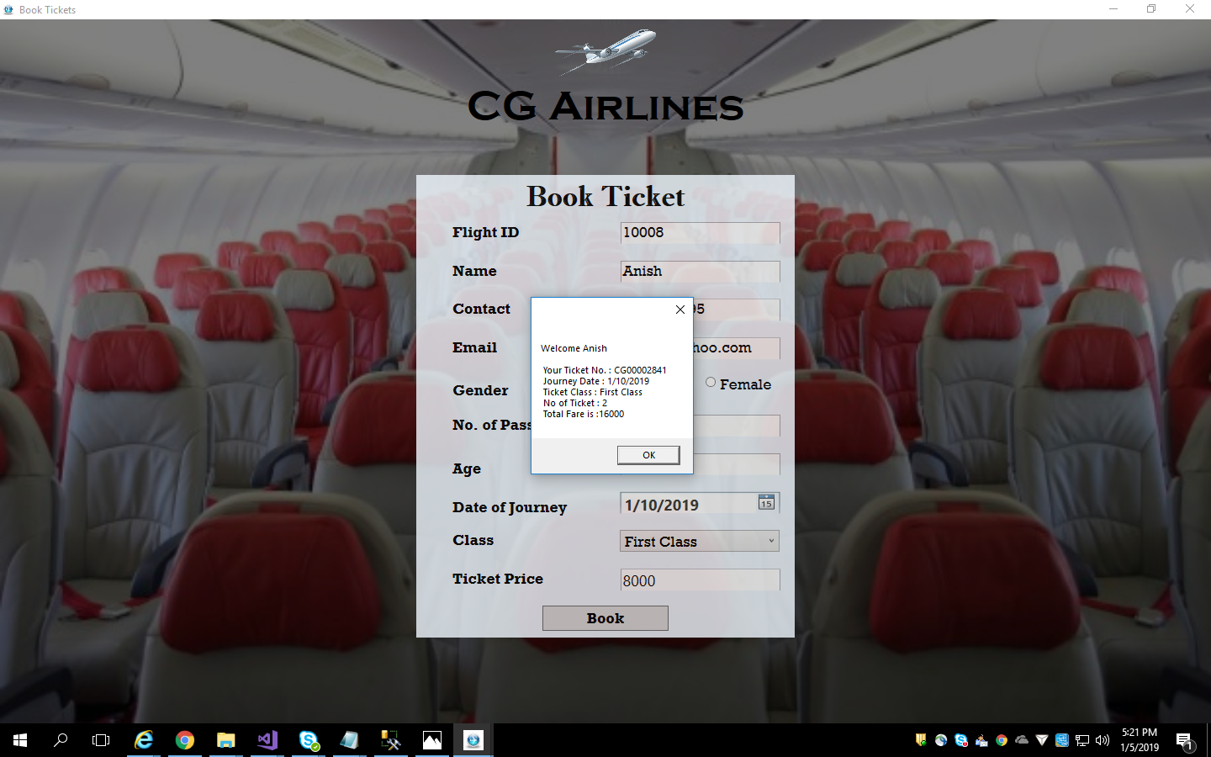
Book Ticket

Slide 13
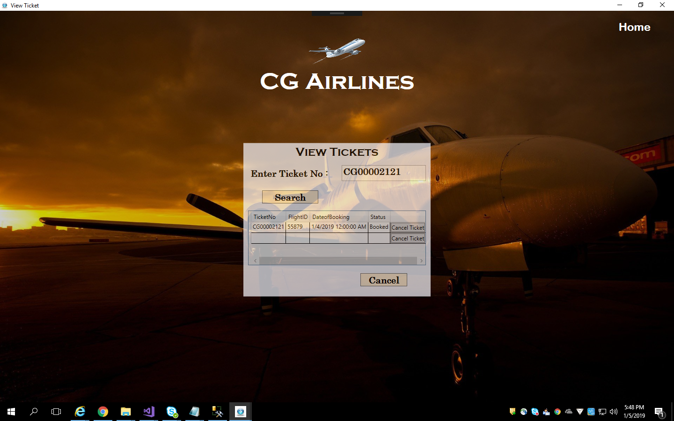
View Ticket

Slide 14
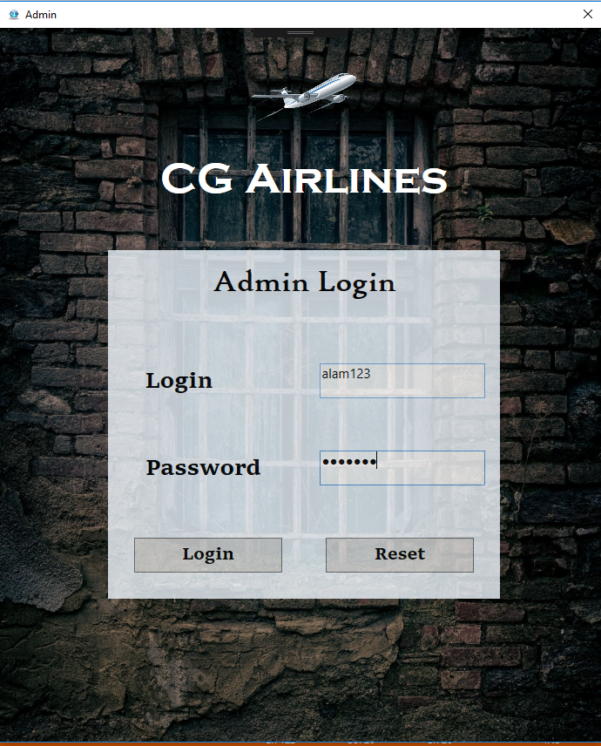
Admin Login

Slide 15
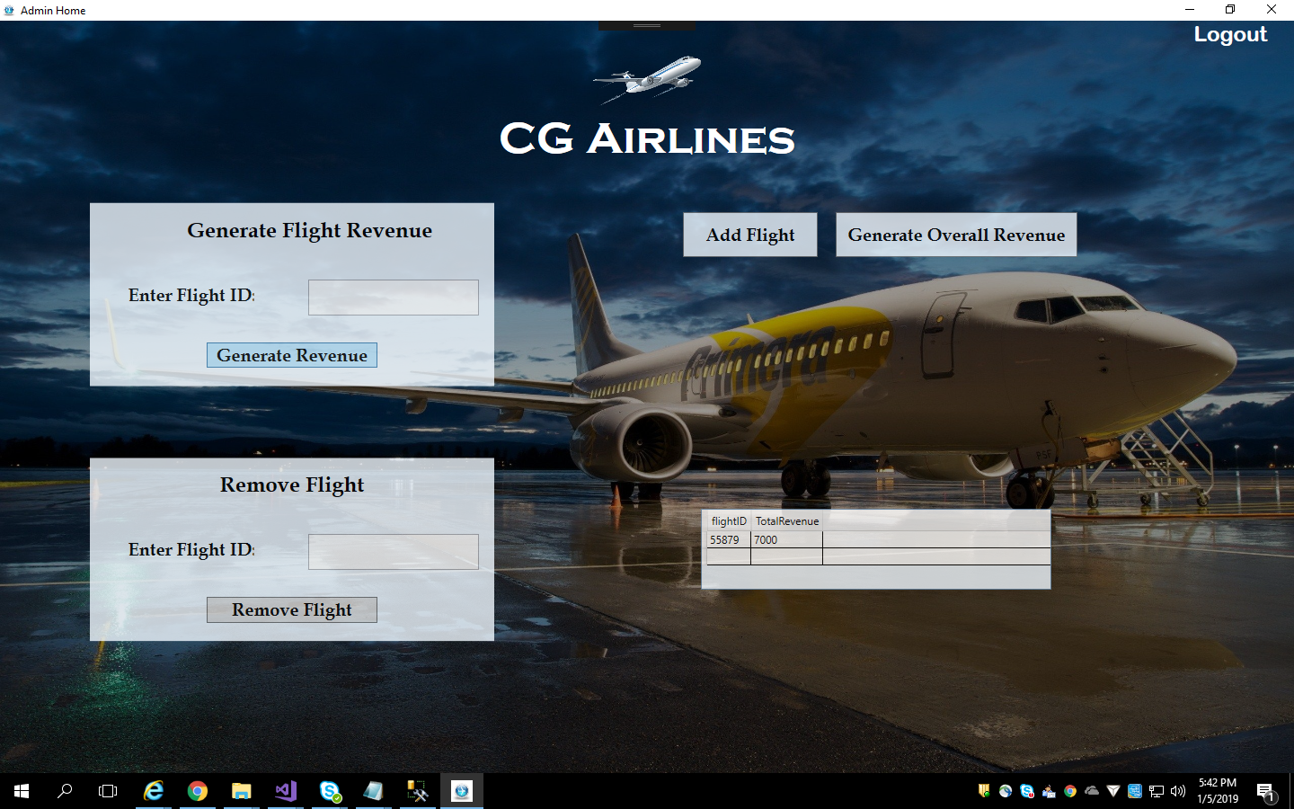
Admin Window

Slide 16
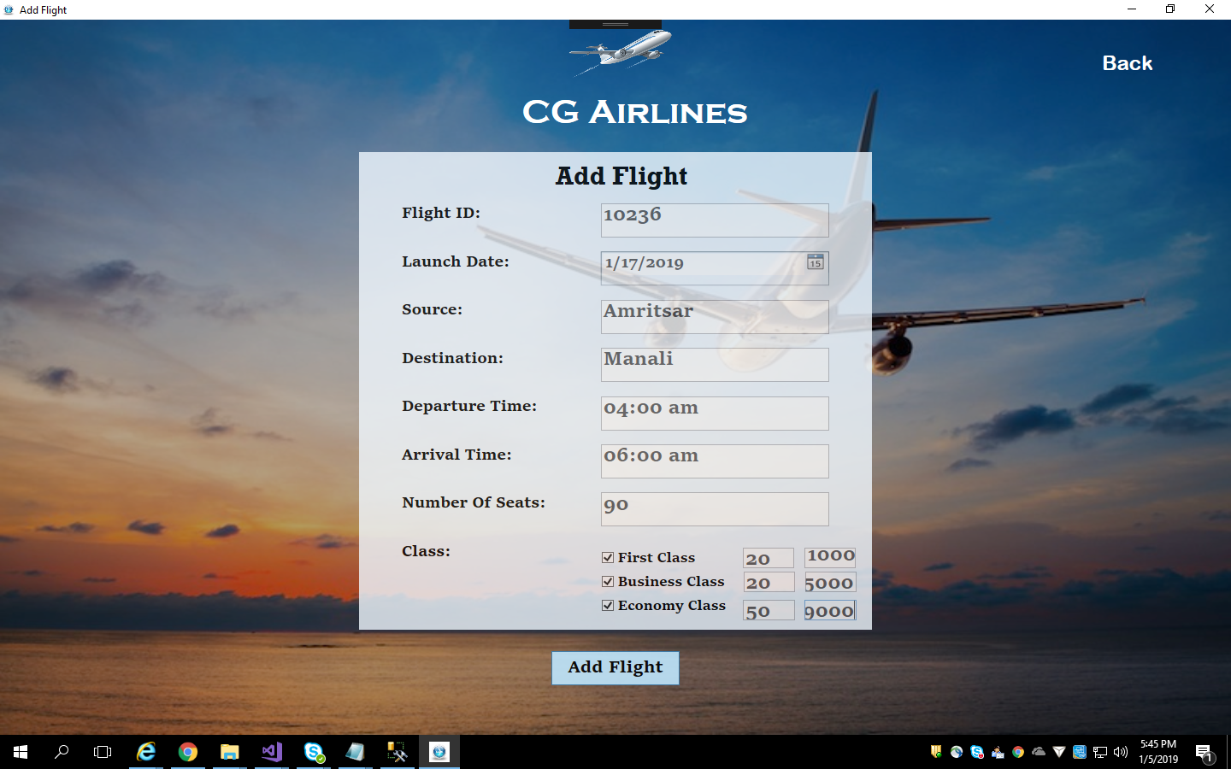
Add Flight

Slide 17
Future Enhancements
We are trying to give customers a report about Available Flights, Pricing and Cancellation of Tickets.
Our future planning is to build this project by using ASP.NET or ASP.NET MVC Technology.
So that, customers can access this application by using any web browser from any location.

Slide 18
Thanks

